Slide 1

DIGITAL
CAMP DIRECTORS MEETING 2025

Slide 2

Dr. Eve Walter, PhD
Public Health Director
845-340-3009
Laura Bell
Environmental Health Manager
lbel@co.ulster.ny.us 845-340-3028
Jeffrey DeKoskie
Senior Public Health Sanitarian
jdok@co.ulster.ny.us 845-340-3033
Brianna Hafner
Public Health Sanitarian
bhaf@co.ulster.ny.us 845-340-3019
Scott Scrodin
Public Health Sanitarian
sscr@co.ulster.ny.us 845-340-3928
Tim Rose P.E., BCEE, QEP, M.P.A.
Director of Environmental Services
845-340-3031
Ulster County Dept. of Health
Main- 845-340-3010
After Hours- 845-943-6104
Fax- 845-340-3045
UCDOH Children’s Camp Webpage
https://ulstercountyny.gov/health/childrens-camps

Slide 3

PRE-OPERATIONAL INSPECTION PREPAREDNESS
In your packet, you have received a Pre-Op Inspection Date. If this date does not work for you, please reach out ASAP so we can reschedule.
Please be as prepared as possible, this includes having copies of service records including alarm system, sprinkler system and fire extinguisher inspections!
Common Violations for Pre-Op Inspections Include:
Improper door hardware
Blocked exits
Alarm Panels not properly functioning
Units lacking smoke detectors/ CO detectors
These are all Fire Safety Concerns!
If your onsite water system is not properly functioning or lacking a detectable chlorine residual, please let us know before we go out to do your preop, we do not have the time to inspect everyone twice!

Slide 4
IN-SESSION INSPECTION PREPAREDNESS
In your camp packet, you have received a PURPLE colored paper, this outlines administrative requirements you can expect us to check during your in–session inspection.
Safety/Medical
-Copy of UCDOH Permit
-Current copy of camp’s written Safety Plan
-Record of Camper Orientation
-Fire drill logbook
-Service records for fire alarm/suppression systems
-First Aid supplies, CPR mask, & AED
-Medical Log Book
Camper Records
-Record of Camper Orientation
-Emergency Contacts
-Medical History Forms, including allergies, medications, immunizations, any medical exemption paperwork
-meningitis form
Staff Records
-Application with reference check documented
-Record of Staff Orientation
-Aquatics Director Written Review of Aquatic Safety Plan

Slide 5

2024 CHILDRENS CAMP RECAP
ULSTER COUNTY:
Most common Day Camp Violations:
Fire Safety and Swimming (buddy check, lack of CPR mask).
Camper Medical History and Personnel Records.
Most common Overnight Camp Violations:
Fire Safety.
Labeled Exits, emergency lighting, electrical and building safety.
NYS Recap: (not final data) 984 reportable injury/illnesses reported
Fatalities- 0
Drownings- 0
Outbreaks- 99, with 32 covid outbreaks, with 146 individual positive cases
Injuries- 565, most common injuries are fractures, cuts, and concussions
Potential Rabies Exposures: 12, with 45 campers potentially exposed

Slide 6

CPR CERTIFICATIONS
CPR certifications are valid for 1 year from the date of certification, REGARDLESS of expiration date on card.
To view the list of accepted courses, please visit The CPR Certification Fact Sheet 2025 on the DOH website https://ulstercountyny.gov/health/childrens-camps
The location of all updated fact sheets can be found in your camp application packet.
*if your course is not listed on the fact sheet, we can not accept it!
Looking for a course? Try your local rescue squad, Red Cross or YMCA.
Check the UCDOH Children’s Camps website for any available information on CPR classes.
Reminder: CPR CERTIFICATIONS ARE VALID FOR 1 YEAR FROM THE DATE OF CERTIFICATION, REGARDLESS OF EXPIRATION DATE ON CARD!!!

Slide 7


AED REQUIREMENT
New as of 2024
Section 3000-F of Public Health Law (PHL) requires all regulated children’s camps to provide an automated external defibrillator (AED) or describe reasonable access to an AED. Additionally, the legislation requires each camp to have one or more staff possessing an acceptable certificate of training in the operation and use of an AED and have an implementation plan. The law requires camps to make one AED available at camp or describe reasonable access to one AED available to the camp. AEDs are not required to accompany camp trips. AED must be kept in a location accessible to trained staff at all times the camp is in operation. AEDs provided by facilities such as schools, parks, and other facilities/locations where camp is held can satisfy the PHL requirement if the camp has access to the AED. If your camp is utilizing an AED provided by another facility, please advise the facility that the camp is relying on the AED to satisfy this PHL. Camps that are establishing their own AED program (also known as a Public Access Defibrillation program (PAD) should consult with their Emergency Health Care Provider as required by NYSDOH Bureau of Emergency Medical Services.
Most CPR certifications satisfy the AED training portion of this requirement.
An AED Plan addition to your safety plan is required before receiving your permit.
For more information, please visit the UCDOH Children’s Camp webpage.

Slide 8

FOOD ALLERGEN NOTICE
New as of 2024 (For camps which provide food services.)
This must be done in ADDITION to the Children’s Camp requirement of maintaining lists of any camper with a food allergies.
In November 2022, Governor Hochul signed into law New York State Senate Bill 8102A, which, through the creation of a new section 1356 of Public Health Law, requires food service establishments to post a notice to their employees raising food allergy awareness. The notice must contain information on
the process to follow when a customer notifies an employee of a food allergy,
how to avoid cross-contact, and
the procedures to be followed in the event a customer experiences an allergic reaction, including when to call 9-1-1.
The notice must be posted in a conspicuous location, and in at least one of the languages spoken by each employee.
Preventing cross-contamination is a key to ensuring the safety of campers with allergies!
For a printable NYSDOH Food Allergen Poster, and more information, visit the UCDOH Children’s Camp Webpage.
Allergic reactions can be life-threatening.

Slide 9

NATIONAL SEX OFFENDER LEGISLATION
NEW as of 2023
This must be done in ADDITION to NYS Sex Offender Registry Search
In June 2022, the Governor signed legislation amending Public Health Law and General Business Law to require children’s camp operators to ascertain whether an employee or volunteer is listed on the National Sex Offender Registry using the National Crime Information Center. This is to be done prior to the day such employee or volunteer commences work at such camp and annually thereafter prior to their arrival at such camp. However, because the National Crime Information Center database cannot be accessed by camp operators, the Department will accept checking staff against the United States Department of Justice National Sex Offender Public Website (nsopw.gov), which is available to the public. Camp operators are directed to enter the individual’s first and last name in the “Search by Name” field, then click on “Name Search”. After agreeing to the conditions of use and entering the captcha, you will see the results of your search. The results will indicate that a national search including all states and territories were performed.
The results from the NSOPW website must be printed for each staff member.
A search may identify records of individuals who share a name with the camp staff. It is the camp operator's responsibility to review any records generated and verify that the staff member is not any of the individuals identified by the search.
This will be reviewed at the time of inspection and again, does NOT take place of the NYS Sex Offender Registry Search Procedure for Children’s Camps
Further directions are included in the Children’s Camp Packet, and on UCDOH Children’s Camp Webpage

Slide 10


RABIES 2024
Rabies is a fatal but preventable viral disease, transmitted through direct contact (such as broken skin or mucous membranes in the eyes, nose, or mouth) with saliva or brain/nervous system tissue from an infected animal.
Number of Animals tested in Ulster County | 72
Number of Positive results in Ulster County | 9
Number of individuals who were approved for Post Exposure Treatment in Ulster County | 135
Number of Animals tested in NYS* | 4,190
Number of Positive results in NYS | 251
* Excluding Bronx, New York, Queens & Kings County
6 bats and 3 racoons in UC tested positive for rabies in 2024!

Slide 11

RABIES- Bats
Bites from a bat can often go undetected.
If ANY exposure to a bat occurs, or a bat is found in a room where someone was sleeping, or someone was present who could not communicate (i.e. infant, young child, person with sensory or mental impairment):
-Notify your local health department and describe the circumstances.
-Try to confine or capture the bat, without causing damage to the head.
-To aid in capturing bats, camps, especially overnight camps, are encouraged to have a bat capture kit consisting of:
Gloves (heavy, preferably pliable thick leather), forceps (9” to 12’ length, rat-tooth for gripping), extension pole with net (fine mesh insect net of polyester or muslin material with a spring steel hoop on telescoping pole – net and pole sold separately) Coffee can w/tight-fitting lid or similar container (e.g., cardboard ice cream carton w/lid; keep multiple containers on hand) Sheet of cardboard to slide between wall and container to act as a lid, tape (to secure lid on container), and flashlights (including fresh batteries & extra batteries)
-General Guidelines for Management of Bat-related Incidents at Children’s Camps can be found on the UCDOH website.
If you are not able to capture and submit the bat to the UCDOH for testing, you may meet the criteria for post exposure treatment (4-5 shots)!

Slide 12

VACCINE PREVENTABLE DISEASES
As of 2019, Ulster County has required all campers to be fully immunized against diptheria, haemophilus influenza type b, hepatitis b, measles, mumps, poliomyelitis, rubella, tetanus and varicella (chicken pox)
Doses are: 2 MMR, 1 Tdap; 2 Varicella; 3 doses of Hepatitis B and 4 doses of Polio (2 months, 4 months, 6-18 months, and 4-6 years)
We do not accept religious exceptions to vaccinations, only valid medical exemptions with documentation.
With cases on the rise, we also strongly recommend all staff to be fully immunized against measles and all other vaccine preventable diseases.
For information on how to join NYSIIS, (NYS Immunization Information System) to obtain vaccination information for children attending camp, please visit the UCDOH Children’s Camp Webpage

Slide 13

What is with the MENINGITIS statement the DOH asks my overnight camp to show???
Well, Meningococcal Disease is a rare, but very serious illness caused by a type of bacteria called Neisseria meningitidis. Even if treated quickly, Meningococcal disease can cause long-term problems or be deadly.
When someone has Meningococcal Meningitis, the tissue covering the brain and spinal cord becomes infected and swells. Symptoms of Meningococcal Meningitis include sudden onset of fever, headache, and stiff neck.
GETTING VACCINATED IS THE BEST WAY TO PREVENT MENINGOCOCCAL DISEASE!
Meningococcal Acwy (MENACWY) vaccine is recommended at age 11/12 years, with a booster dose at age 16. In NYS, these vaccinations at their recommended ages, are required for school attendance.
PLEASE NOTE: The NYSDOH does not recommend that campers receive either dose of MENACWY vaccine before the recommended ages. Students who are vaccinated before the recommended ages may need to have the doses repeated to attend school.

Slide 14
MENINGITIS Parent Letter & Response Form
An overnight camp must provide parents/guardians of campers attending camp for seven (7) or more consecutive nights with written information about meningococcal meningitis and with a copy of an immunization response form that has been approved by the state commissioner of health. THE WRITTEN STATEMENT MUST INCLUDE:
A description of Meningococcal meningitis and means of transmission;
The Benefits, risks and effectiveness of immunization; AND
The availability and estimated cost of immunization, including an indication of whether or not the camp offers Meningococcal Meningitis immunization services
THE IMMUNIZATION RESPONSE FORM MUST BE SUBMITTED ANNUALLY, KEPT ON FILE AT CAMP, DOCUMENT THAT THE PARENT/GUARDIAN HAS RECEIVED AND REVIEWED THE MENINGOCOCCAL MENINGITIS INFORMATION AND CERTIFIES THAT EITHER:
The camper has been immunized against Meningococcal Meningitis within the past ten years, OR
The parent or guardian understands the risk of Meningococcal Meningitis and the benefits of immunization against Meningococcal meningitis
MENINGOCOCCAL PARENT LETTER and the MENINGOCOCCAL RESPONSE FORM can be found on the UCDOH Camp Webpage.

Slide 15

REQUIRED REPORTING FOR INJURY & ILLNESS
The following Injuries/Illnesses must be reported within 24 hours
-Camper and staff injuries or illnesses which result in death or require resuscitation, admission to a hospital or the administration of epinephrine
-Camper or staff exposures to animals potentially infected with rabies
-Camper injuries to the eye, head, neck or spine which require referral to a hospital or other facility for medical treatment
-Injuries where the camper sustains second or third degree burns to 5 percent or more of the body
-Camper injuries that involve bone fractures or dislocations
-Lacerations sustained by a camper which require sutures, staples, or medical glue
-Camper physical or sexual abuse allegations
-Camper and staff illnesses suspected of being water-, food- or air-borne or spread by contact
See salmon-colored required reporting form in your application packet.
Report forms for all the above are posted on the UCDOH Camp Webpage.
An Injury/Illness logbook must also be kept on site and accessible for review during an in-session inspection. Failure to report any of the above Injuries or Illnesses will be cited on the inspection form and may result in enforcement.

Slide 16
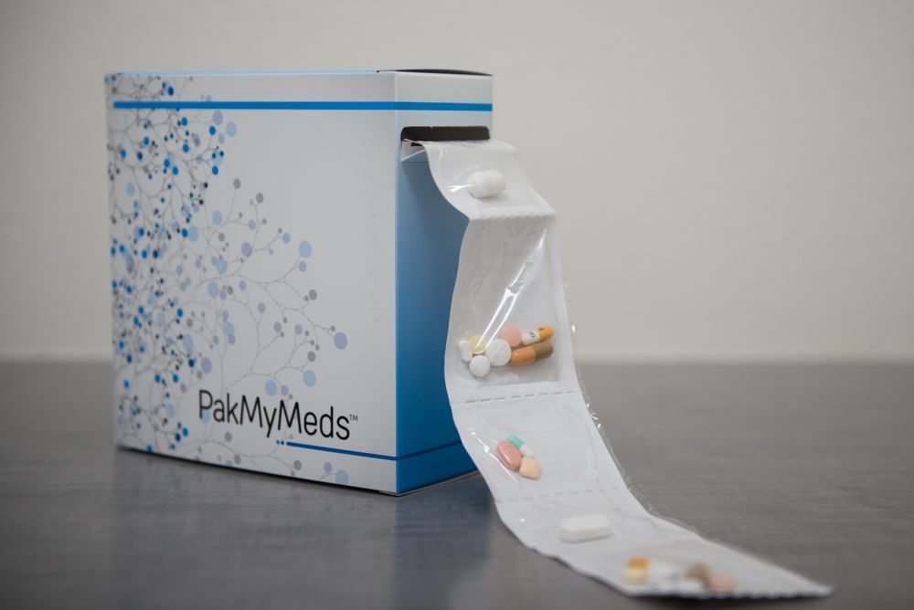
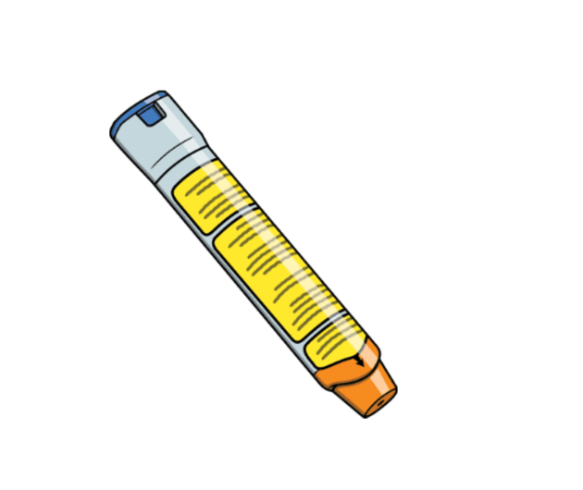
MEDICATIONS AT CAMP-
Collection, Storage & Administration
COLLECTION: Medications should not be transported daily to and from camp. Parents/guardians should request the pharmacy provide two containers, one for home, and one for camp or they can use a pharmacy service that provides prepackaged daily medications.
With the exception of Epinephrine Auto-injectors, prescription medication must be prescribed and dispensed to an individual. Camps may not maintain a bulk supply of prescription medications.
Over the counter medication may be stockpiled but requires completed standing orders to be administered.
Day camps – Many day camps choose to have parents come to camp during the day to administer medications as opposed to the camp having the responsibility of maintaining the medication. As stated above, it is not ideal for day campers to have to transport medications daily.

Slide 17


MEDICATIONS continued
REPACKAGING OR RELABELING OF PRESCRIPTION MEDICATION IS PROHIBITED.
This includes bulking of individual prescriptions for one patient. Prescription medications must be in their original containers with labels that include but is not limited to:
-Complete name of patient, date prescription filled, expiration date, directions for use, precautions (if any), and storage (if any), dispensing pharmacy name and address, name of physician prescribing medication.
Upon arrival at camp, campers and staff (who are housed with campers), must provide their medications (prescriptions and non-prescription/vitamins) to the camp’s health director or designee.
The health director will review licensed prescriber’s written orders and health histories to ensure required medication have been turned in and properly ordered. Any inconsistencies between health records and medications brought to camp shall be resolved by contacting the parent/guardian. Additional follow-up with the camper's physician may be necessary.
When transportation is provided to camp from a common pick-up point, all medications will be collected prior to campers getting on the bus.
Repackaging is prohibited .

Slide 18

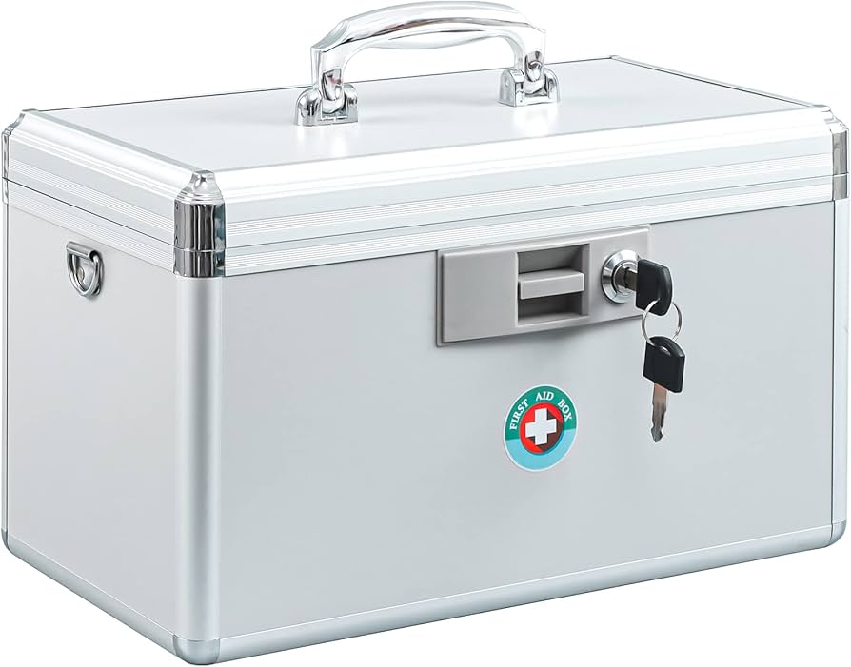
MEDICATIONS continued
STORAGE: All medications are to be stored per product directions (i.e., refrigerate, avoid excessive heat) and kept in a secure, LOCKED, area accessible only to the Camp Health Director/designated staff.
Individuals that need emergency medications, such as an Epi-Pen or Inhaler, may carry the medications themselves. If necessary, staff may be assigned to carry the medication; ensuring that the patient and medication always remain in close proximity.
Controlled substances (narcotics) and syringes must be “double-locked” (i.e., locked in a box locked in a cabinet) and standard of best practice followed, including counting the controlled substances upon arrival and periodically thereafter.

Slide 19


MEDICATIONS continued
ADMINISTRATION: When the parents/guardians are not available to administer medications, two options are available:
Administration by a licensed health care practitioner (physicians, nurse practitioners, physician assistants, registered professional nurses, and licensed practical nurses)
0R
Self-Administration
An EMT employed by a children’s camp is not working for an established EMS and therefore cannot administer medications.
First aid staff and staff without medical certification/license are prohibited from administering medication as well.

Slide 20
MEDICATION ADMINISTRATION continued
By LICENSED HEALTH CARE PRACTITIONER
By SELF-ADMINISTRATION
Only a NYS-licensed health care practitioner may administer medications (prescription and over-the-counter) at a children's camp when following orders that are written specifically for an individual camper. A Licensed Practical Nurse (LPN) must work "under the direction" of a NYS licensed physician, other licensed health care provider or registered nurse. An LPN cannot legally assess a patient's/camper's condition. They can administer medications following a patient specific order; however, in the case of as needed orders, an LPN must first confer with the RN or licensed health care provider he/she is working "under the direction" of. For additional clarification or questions regarding licensed health care practitioner's scope of practice limitations, contact the NYS Education Department at (518) 474-3852 or visit their website: http://usny.nysed.gov/professionals/.
Patient-specific written orders from and signed by a licensed prescriber, describing use of the medication, are required for a nurse to administer or to allow a camper to self-administer a medication (prescription and over the counter). Parental permission by itself is not sufficient.
Self-administration of medications will only be allowed for those individuals determined to be "self-directed". Determination as to whether or not a camper should be considered for self-administration will be conducted by the health director or designee and will be based on the camper's ability to:
· Identify the correct medication (e.g., color, shape), · Identify the purpose of the medication (e.g., to improve attention),
· Determine that the correct dosage is being administered (e.g., one pill),
· Identify the time the medication is needed (e.g., lunch time, before/after lunch),
· Describe what will happen if medication is not taken (e.g., unable to pay attention), and
· Refuse to take medication if camper has any concerns about its appropriateness.
Camper will not be allowed to self-administer "as needed" medications, except for emergency medications such as inhalers and Epi-pens.

Slide 21

MEDICATION ADMINISTRATION continued
Self-Administration Procedures:
· The camp health director, or designee trained by the health director in self-administration procedures, will keep a list of all campers in their charge requiring medications, the medication needed, time and dosage to be taken. The camper will be reminded each time when a scheduled dose is to be taken and will read or be read the name of the medication, dosage and other instructions for use.
· At the time of self-administration, the health director or designee will verify who the camper is and that he or she has the correct medication, dosage and other use instructions.
· Medication will be handed, in the original container, to the camper for self- administration. Camp staff that are not licensed health care practitioners may not pour or dispense pills into containers for ingestion. Staff that remove medication from the original container are administering medication. Staff may help a camper loosen the container cap, if necessary.
· Administration of the medication will be witnessed and documented by noting (in the medical log or recipient's medical record) the names of the recipient, medication, dosage, witness, and the date and time self- administered.
· Medication will be returned and properly stored.

Slide 22
MANDATED REPORTING
You, as Directors of children’s camps ARE mandated reporters!
NYS recognizes that certain professionals are specially equipped to fulfill the important role of mandated reporter of child abuse or maltreatment. Mandated reporters are required to report suspected child abuse or maltreatment when, in their professional capacity, they are presented with reasonable cause to suspect child abuse or maltreatment
Allegation of Abuse Report Form DOH- 61 can be found on the UCDOH webpage.
Mandated reporters can participate in a 2-hour web-based online training course at any time, 24/7, provided by the Office of Children and Family Services at
https://ocfs.ny.gov/programs/cps/mandated-reporter-training.php

Slide 23

TRIP SWIMMING AND AQUATICS DIRECTOR
IF YOUR CAMP PLANS ON SWIMMING, EVEN FOR A 1-DAY FIELD TRIP, YOU ARE REQUIRED TO HAVE AN APPROVED CAMP TRIP SWIMMING SAFETY PLAN APPENDIX ON FILE AND A CERTIFIED AQUATICS DIRECTOR!
A Camp Aquatics Director must oversee all swimming activities that occur at swimming pools and bathing beaches operated as part of a children’s camp.
-when swimming is onsite, this person shall supervise lifeguards and other required staff during swimming activities and implement the camp safety plan and oversee all aspects of the buddy check
-when swimming is offsite, they must implement the camp safety plan and oversee all aspects of the buddy check
Although the Lifeguard Management class is only being offered online, certifications must be accompanied by a separate certification or statement from the instructor indicating an in-person testing session

Slide 24
AQUATICS DIRECTOR
THE CAMP AQUATICS DIRECTOR MUST:
-Be at least 21 years of age and have a minimum of:
-one season of previous experience as a camp aquatics director at a NYS children’s camp; OR
-two seasons of previous experience consisting of at least 12 weeks as a children’s camp lifeguard which had more than one lifeguard supervising it at a time; OR
-18 weeks of previous experience as a lifeguard at a swimming pool or bathing beach, which had more than one lifeguard supervising it at a time
*you do not need a current Lifeguard certification.
-Hold an accepted and current cardiopulmonary resuscitation (CPR) certificate as listed on the Fact Sheet
-Annually review and document the review of a camp’s safety plan for swimming
EXAMPLE: I ________, the aquatics director for camp ________, have reviewed the camp safety plan and will operate the aquatics program accordingly.
Date _____.

Slide 25
AQUATICS DIRECTOR continued
A WSI (water safety instructor) or a PSI (progressive swim instructor) is not an Aquatics Director. The Aquatics Director must have the Lifeguard Supervision and Management, or Lifeguard Instructor certification, but an Aquatics Director may ALSO be your WSI and Lifeguard if certified to do so.
An Aquatics Director may not:
-perform lifeguard duties unless currently certified as a qualified lifeguard, OR
-assess swimming ability unless currently certified as a PSI or WSI
The lifeguard must always be on the pool deck and not in the pool with campers unless an additional lifeguard is on deck.

Slide 26


BUDDY CHECK
Failure to implement a complete buddy system has been a significant contributing factor in EVERY camper drowning related to a children’s camp since 1986.
A WSI/PSI assesses the swim ability of all campers.
Campers are broken down into buddy pairs with a similar swim abilities and given buddy numbers.
Campers swim level must easily be identified. This is often by using a colored wrist band or bathing cap.
If there is an odd number of campers ONE triple pair is allowed for each swim level.
If a swimmer is paired with a non-swimmer, both bathers must stay in water less than chest deep or in the non-swimmer section.
If the shallowest part of the pool is still greater than chest deep on a non-swimmer, an approved alternate procedure must be addressed in the camp safety plan.
A buddy check is to be conducted every 15 minutes or less, often by a whistle and a “BUDDY CHECK!”
Buddies must stay still and close together until accounted for. This is generally done by going to the side of the pool or getting out of the water. Staff should then verify that the have the correct number of buddy pairs in their section and verify the count with the staff maintaining the buddy board/accounting system.
Campers must wait for signal to return to swimming. On average, buddy checks should take no more than 60 seconds.

Slide 27
BUDDY CHECK CONTINUED
Having a buddy pair when one camper is in the water and one camper is on the deck is NOT an adequate buddy pair and the camp will be cited a critical violation. This was a common violation cited in 2022, 2023 and 2024.
Campers at an OPWDD camp need a signed permission slip for all swimming.
Also, all camps, when swimming is conducted during camp trips including aquatic amusement park activities, each camper shall have a signed statement of permission to participate from a parent/guardian.
Example buddy clip board sheets can be found on the camp web page.
Swimming is the most dangerous activity done at camp and an appropriately orchestrated buddy system could save a life!
Buddy checks that take longer than 60 seconds to conduct may be an indication that the camp is not routinely implementing or not understanding the mechanics of the buddy system.

Slide 28

HARMFUL ALGAL BLOOMS (HABS)
Under the right conditions, algae may grow out of control, discolor the water, eat up all the oxygen, and produce a harmful environment for both plants, animals and humans. Some of these “blooms” can produce toxins.
Be sure to monitor your natural recreational water for any signs a harmful algal bloom (HAB)
HABS can cause illness in humans and animals
If you notice any signs of a HAB, discontinue all related recreational water uses and contact the UCDOH
There have been multiple HAB beach closures in Ulster County!

Slide 29

SUPERVISION RATIO REMINDER
Passive Activity – 1:25
Camp Trip Activities Including Swimming
6 yrs & older – 1:8
Less than 6 yrs – 1:6
Non-ambulatory camper – 1:2
Day Camp – 1:12
Non-ambulatory or uncontrolled epilepsy – 1:1 for aquatic activity
Overnight Camp
8 yrs & older – 1:10
Less than 8 yrs of age – 1:8
20% of counselors can be 17
Wilderness swimming
6 yrs & older – 1:8
Less than 6 yrs – 1:6
Developmentally disabled camper’s aquatic ratio other than described above – 1:5
Rest Area – 1 counselor per sleeping area
Boating
6 yrs & older - 1:8
Less than 6 yrs of age – 1:6
Boats with 8 or more campers carrying non-swimmers need a lifeguard in boat
Transportation – 1:12
Lifeguard – 1:25
Aquatics Activities
8 yrs & older – 1:10
6 & 7 yrs of age – 1:8
Less than 6 yrs of age – 1:6
YOUR LIFEGUARD DOES NOT COUNT AS A COUNSELOR!
Archery – 1:10
Horseback Riding
6 yrs & older – 1:8
Less than 6 yrs of age – 1:16

Slide 30

WATER SAMPLING
NITRATE SAMPLE is to be taken PRIOR to your permit being issued. It is to be taken before treatment and one sample it to be collected from each well.
Consuming too much nitrate can affect how blood carries oxygen and can cause Methemoglobinemia (also known as Blue Baby Syndrome)
BACTERIOLOGICAL SAMPLE to be taken each month camp is in operation, even if it is only for a portion of the month (YES- one day of the month counts!)
Consuming contaminated water can cause illness, which spreads quickly and can be particularly harmful to children.
PRE-OP SAMPLES can count towards your routine (bacteriological) sample for the month in which it was collected.
Failure to submit sample results or operation sheets by the 10th day of the following month will result in enforcement!
Once you receive your sample results, e-mail to dohnc@co.ulster.ny.us
If you receive a bad sample result, immediately report the result to lbel@co.ulster.ny.us

Slide 31

WATER- WELL DISINFECTION
Prior to taking any samples
All wells and distribution systems that are not operated continuously should be disinfected to neutralize any contamination that might have been introduced into them by equipment, material, surface drainage, construction or repair. The following steps must be taken for each water system and completed at least 15 days prior to the property’s occupancy:
Well Disinfection
  1. Prepare a strong chlorine solution by using 2 quarts of an NSF approved unscented hypochlorite or bleach in 5 gallons of safe water. Pour this directly into the well. These doses may vary according to well depth and are good for wells up to 150 feet.
  2. Draw water until a strong chlorine odor is present at a tap at the beginning of the distribution system. Allow the well to sit idle for at least 24 hours. Do not use the water during this time.
  3. After 24 hours let the well pump to waste, preferably through an outside tap being careful not to allow the water to flow on shrubbery or flowers. This should be done until the chlorine odor is no longer apparent at the tap.

Slide 32
WATER-DISTRIBUTION DISINFECTING
Distribution Disinfection
(1) All water mains shall be disinfected by filling the main to remove all air pockets, flushing the main to remove particulates, and filling the main with potable water. The potable water shall then be chlorinated by feeding liquid hypochlorite at a constant rate such that the water will not have less than a 25 mg/l free chlorine residual (25 ppm) throughout the water system. After a 24-hour holding period there must be a free chlorine residual of not less than 10 mg/l throughout the children’s camp water system.
(2) All water mains shall be flushed, and free chlorine residual disinfection concentrations shall be measured for the two days immediately following the completion of the main disinfection at representative points in the distribution system to ensure chlorine residuals of not less than 0.2 mg/l.
(3) A Total Coliform sample shall be collected from each water source at a representative point in the distribution system following the two-day flushing and chlorine monitoring period and when a free chlorine residual of not more than 2.0 mg/l is present. Pre-operational water analysis reports must be submitted to the permit-issuing official prior to permit issuance.

Slide 33

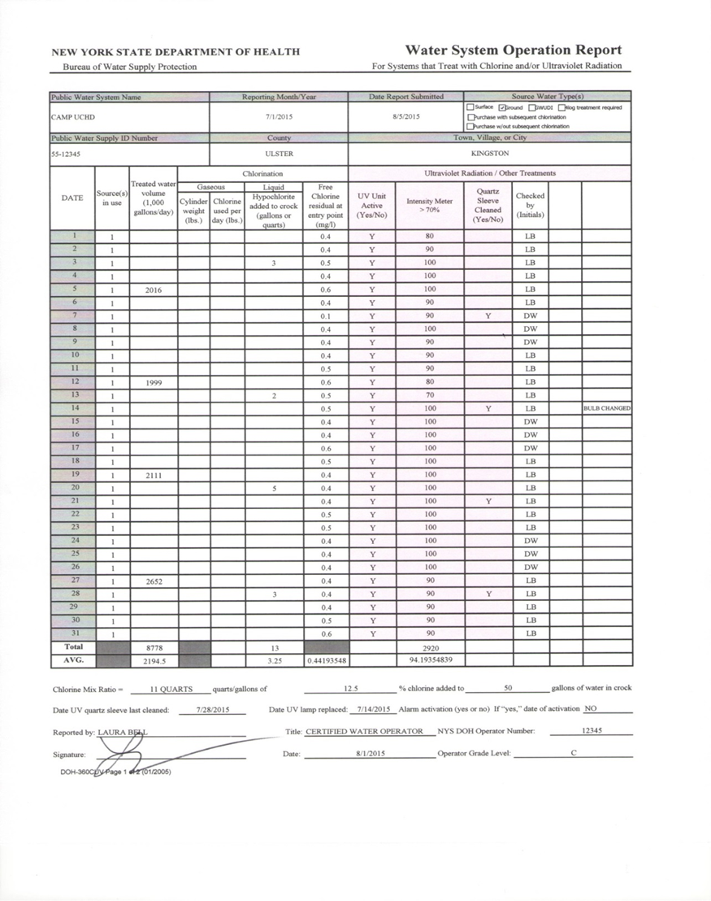
MONTHLY OPERATION REPORT (MORs)
A chlorine residual, (or check of UV system) is required to be noted on a MOR sheet every day camp is in session.
A chlorine residual is to be maintained throughout the distribution system at a minimum of 0.2 PPM and a max of 4.0 PPM.
Each camp with a water system has received a copy of their own MOR in their packet. Please refer to “Drinking Water Operation Sheets” under UCDOH Children’s Camp Webpage for additional copies.
These MORs are to be sent to dohnc@co.ulster.ny.us by the 10th of the following month.

Slide 34

Sample Siting Plan
All facilities with onsite wells are to complete the Sample Siting Plan enclosed in their application packet and submit it to this department before permits are issued for the 2025 camp season. If you have any questions on your water system, please reach out to this department.

Slide 35

Bird Flu (H5N1)
H5 bird flu is widespread in wild birds worldwide and is causing outbreaks in poultry and U.S. dairy cows with several recent human cases in U.S. dairy and poultry workers.
While Bird Flu has been in the US since 2022, with 68 cases found in humans, there has been a major uptick in bird flu cases in birds and mammals in 2025.
Person to person transmission has not been identified.
Because transmission is believed to be spread via bird waste, it is advised to clean up bird waste (i.e. goose poop at a beach/lake/field etc.) if possible.
Unpasteurized milk can also spread H5N1.
Avoid contact with dead birds, and if you must, handle them with caution. Using proper PPE dead bords can be triple bagged and reported to USDA's toll-free number at 1-866-536-7593.

Slide 36

LAST REMINDERS:
Please make sure that you fill in your e-mail address on your permit application. Inspection records are digital, so without an email address linked to your facility, it is difficult to receive your inspection reports and other important information.
As always, permits will not be issued until we have received all application paperwork and all staff certifications.
Please send an e-mail confirming you have reviewed this training to bhaf@co.ulster.ny.us
THANK YOU! SEE YOU ALL SOON!

