Slide 1
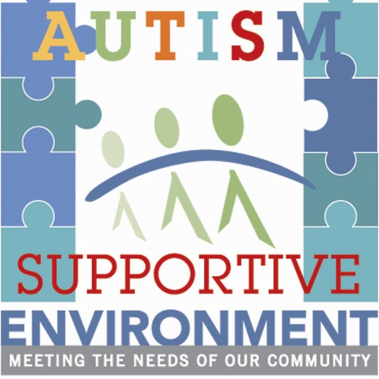
Introduction to Autism Spectrum Disorder
Anderson Center Consulting

Slide 2
We would like to thank
Ulster Community Grants Fund
of the Community Foundations
of the Hudson Valley
for their collaboration in offering this Autism Supportive Environment℠ presentation

Slide 3
What is Autism?
Do You know?
Autistic
AUTISM
autism
Autism Spectrum?
ASD?

Slide 4
Basics of Autism Spectrum Disorder (ASD)
Autism is a neurodevelopmental disorder that appears very early in life.
There is no known cure for autism, but many individuals with this diagnosis can experience good outcomes with intervention.
Autism is characterized by disordered or delayed development in basic human interactions such as the ability to identify and express feelings, communicate with others, and establish social relationships.

Slide 5
Basics of Autism
The precise neurobiological mechanism that causes autism is not known, so the primary method for determining if a child has autism is through the observation of behavioral characteristics.
Autism Spectrum Disorders are unique when compared to other developmental disorders in that, with appropriate and intensive early intervention, the deficits that characterize the disorder may be significantly reduced, and in some cases completely eliminated.

Slide 6
ASD Facts & Statistics
Fastest-growing developmental disability in the United States
44% have average to above average intellectual ability
83% co-occurrence with other non-ASD developmental disability
Males are diagnosed with Autism four times more frequently than females
10% co-occurrence with psychiatric diagnosis
1:59 children in the United States (1 in 42 boys)
Notes:
Highlight numbers in relation to customers
Number of people and families who are potential “customers”

Slide 7
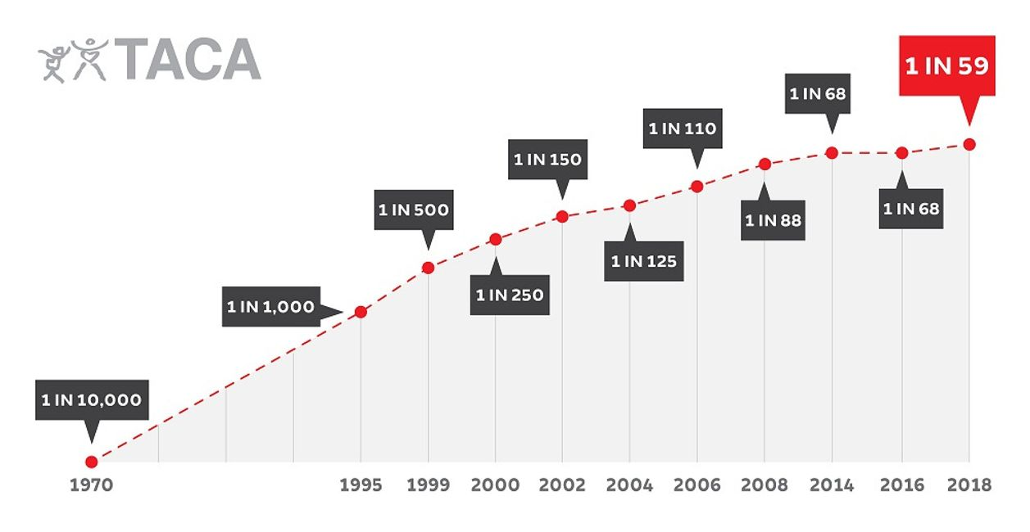
Fastest Growing Developmental Disability in the U.S.

Slide 8
ASD: Autism Spectrum Disorder
What does “spectrum disorder” mean?
Individuals are affected to different degrees from mild to very severe. ASD manifests differently in every person diagnosed.
Autism Spectrum Disorder may or may not occur along with intellectual disability and other specific language disorders.

Slide 9
Brain Research
Research shows differences or interruptions at “critical” points of brain development in people with ASD.
Research has revealed neurodevelopmental differences between people with ASD and people not on the spectrum.
Atypical brain development impacts the “executive functioning” capabilities of people on the spectrum. This has direct implications for the supports necessary to assist people with ASD to be successful in various environments.
What does this mean exactly?
The brains of individuals diagnosed with ASD are “wired” differently than those of individuals who are not diagnosed.
Notes:
Info from Kathleen

Slide 10
Individuals diagnosed with ASD will experience challenges in the following areas (which constitute the Diagnostic Criteria for Autism Spectrum Disorder).
Social
Communication
Restricted Interests/ Repetitive Behavior
Sensory
Notes:
Deficits in Social Interaction
Individuals with ASD have difficulty learning to engage in the give-and-take of everyday human interaction. They may appear as having a preference for being alone, becoming frustrated by interactions with others or lack of the ability to interpret gestures and facial expressions.
Deficits in Communication & Language
Individuals with ASD may have difficulty communicating functionally. Some lack spoken language altogether and are nonverbal, for some there is a delay in the development of speech, while others can speak, they are not able to effectively communicate their needs. Still others have fluent verbal language abilities, but may lack social reciprocity (engaging in the “back and forth” of a conversation) and/or differences with prosody (the cadence or inflection used in spoken language).
Restricted Interests/Repetitive Patterns of Behavior
Individuals with ASD may adhere to certain rituals or a need for structure. Some individuals may want physical objects organized in a precise manner, repeat movements, and/or be preoccupied with a specific interest.
Sensory
Individuals with autism often show pronounced sensory issues. These can be expressed as either an extreme over- or under-reaction to sensory stimulation.

Slide 11
Diagnostic Criteria
Deficits in Social Interaction
Individuals with ASD have difficulty learning to engage in the give-and-take of everyday human interaction. They may appear as having a preference for being alone, becoming frustrated by interactions with others or lack of the ability to interpret gestures and facial expressions.
Deficits in Communication and Language
Individuals with ASD may have difficulty communicating functionally. Some lack spoken language altogether and are nonverbal, for some there is a delay in the development of speech, while others can speak, they are not able to effectively communicate their needs. Still others have fluent verbal language abilities, but may lack social reciprocity (engaging in the “back and forth” of a conversation) and/or differences with prosody (the cadence or inflection used in spoken language).

Slide 12
Diagnostic Criteria
Restricted Interests/Repetitive Patterns of Behavior
Individuals with ASD may adhere to certain rituals or a need for structure. Some individuals may want physical objects organized in a precise manner, repeat movements, and/or be preoccupied with a specific interest.
Sensory
Individuals with autism often show pronounced sensory issues. These can be expressed as either an extreme over- or under-reaction to sensory stimulation.

Slide 13
Changes in Diagnostic Criteria
In 2013, changes were made in how autism is diagnosed. Previously, utilized diagnoses were grouped together as part of the larger autism spectrum. Many people still reference some of these diagnoses to differentiate where they are on the spectrum. Previous diagnoses included:
Asperger’s Syndrome
Individuals with Asperger’s syndrome are now officially considered part of the autism spectrum. They are often referred to as “higher functioning” and often have greater communication skills, but still face the other hallmark challenges of autism (i.e., social skills, repetitive behavior, sensory challenges, and related conditions).
Pervasive Developmental Disorder Not Otherwise Specified (PDD-NOS)
This diagnosis was given to individuals who had many of the deficits of autism but may not completely meet diagnostic criteria or that of another developmental disorder.

Slide 14
Remember, Autism manifests differently in every individual.
Some individuals with Autism may require a high level of supervision and support to complete day-to-day tasks.
Individuals at the other end of the spectrum may be completely independent and possess highly specialized skills.
It may not be obvious that these individuals have a disability.

Slide 15
More on Social Skills
Individuals with ASD often have difficulty with or demonstrate deficits in particular areas of social skills. These may include:
Difficulties understanding body language and nonverbal behaviors (i.e., facial expressions)
Lack of awareness of or misunderstanding of “unwritten” social rules
Personal boundaries: some may lack an understanding of personal boundaries, while others may be uncomfortable with proximity
Failure in or difficulty with developing peer relationships
Lack of spontaneity or seeking to share interest, enjoyment, achievement, etc.
Lack of social or emotional reciprocity
Notes:
Highlight – Do not need to go into detail

Slide 16
More on Communication
Individuals with ASD may demonstrate an array of difficulties in understanding, expressing, and responding to language, including:
A general delay or lack of spoken language
Impairment in initiating and sustaining conversation
Repetitive use of language (scripting, echolalia)
Concrete processing of information and difficulty understanding sarcasm, humor, idioms
Interpreting phrases and common sayings with a literal understanding
May or may not make eye contact, which may make it appear as though they are not listening
Difficulty following directions (particularly those with multiple steps)
Processing delay which will be evidenced in a delay prior to responding
May have difficulty understanding your body language
Notes:
Highlight – Do not need to go into detail

Slide 17
Concrete Processing of Information
Literal-mindedness: Simple cause and effect or a definite answer are more easily understood than concepts that are more abstract.
Phrases such as “It's raining cats and dogs” may actually conjure up an image of exactly that; cats and dogs falling from the clouds.
Sayings such as “break a leg” will likely not be interpreted as a statement offering good luck.

Slide 18
More on Behavior Patterns
Individuals with ASD may engage in patterns of behavior that appear non-functional to the on-looker, this may include:
Preoccupation with restricted interests
Adherence to specific nonfunctional routines and rituals
Repetitive motor manners (stimulatory behavior)
Persistent preoccupation with parts of objects
Need for sameness

Slide 19
Overselectivity
Overselectivity is the tendency to focus on minute characteristics of an object or person, rather than the whole. This could be a focus on just the wheel of a toy car, or fixating on the placement of the zipper pull on a friend’s jacket.
This hinders learning new concepts and interferes with the individual's ability to interpret relevant meaning from information in his or her environment.

Slide 20
Routines and Perseveration
There is often a strong tendency toward establishing and maintaining fixed routines. This may look like:
Insisting upon having everything in the same place all the time and becoming very upset if anything is moved.
Sometimes a verbal child with autism may talk incessantly about one topic, regardless of how bored his listeners are with it, and show no interest in anything else.
A person may ask the same question over and over, regardless of the reply.
Insisting upon doing something in the exact same way it was done previously, or taking the exact same route to a destination.

Slide 21
Self-Stimulatory Behavior
Many individuals with autism exhibit what is called self-stimulatory behavior. This may be referred to as “stimming.” Self-stimulatory behavior can take many forms of rapid repetitive motor movements, sometimes it looks like:
flapping hands rocking back & forth bouncing
tapping objects flicking fingers spinning things

Slide 22
More on Sensory Sensitivity
Often, individuals with autism will display a combination of both hypersensitivity and hyposensitivity to stimuli in their environment.
“Hypersensitive” = over-reaction to stimuli
For example, a person with ASD may be extremely sensitive to noises or being touched, or refuse to wear certain types of clothing, be extremely sensitive to certain textures, tastes, or smells in food and refuse to eat all but a few foods.
Often times, the things in the environment causing such a response, go unnoticed by others.

Slide 23
Sensitivity
“Hyposensitive” = under-reaction to stimuli
A person may seem to need more of every sensation and will actively seek out increased input.
May crave deep pressure.
May constantly run back and forth or jump up and down or spin to give himself/herself more sensory input.
May not seem to feel pain in a typical way.
This can be very dangerous: a child who may not feel heat appropriately, for example, may not sense the danger of a hot pan or a fire and thus can be badly burned .
Being oversensitive to sound, for example, while craving tactile sensation.

Slide 24
Individuals are impacted by developmental
disabilities in many ways, this may also include:
Difficulties with attention
Impulsivity, easily distracted
Difficulty with organization and planning
Comprehension and memory problems
Lack of social skills, leisure skills, and limited interests
Behavioral challenges, emotional changes
Difficulty processing information
Fine/gross motor and coordination difficulties

Slide 25
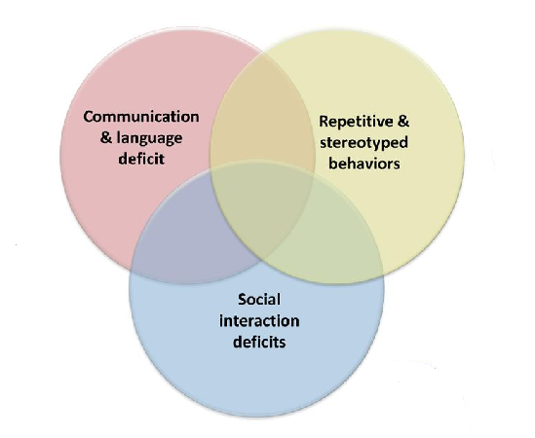
GI Issues
Sleep Issues
Related & Co-Occurring Conditions
Allergies/
Sensitivities
Sensory Challenges
Autism
Seizure Disorders
Depression, Phobias, & Anxiety

Slide 26
Uneven vs. Delayed Development
It is common for a child with ASD to show "splinter" skills, appearing to be highly capable in some tasks (e.g., math computation) but unable to follow simple routines independently or carry on a conversation.

Slide 27
Savant Capabilities
Extraordinary skills in a specific area, often combined with lower than average abilities in other areas of development.
For instance, a child who is not toilet trained or who may not be able to talk may be able to play complex pieces on the piano. These savant capabilities are seen in only around 10% of the individuals who receive a diagnosis on the autism spectrum.

Slide 28
Challenging Behavior
For some individuals, communication and social deficits, coupled with sensory and medical challenges, may result in:
Aggression
Self-injury
Tantrums
Screaming/Cursing
Property destruction
Running/Wandering
Most challenging behavior occurs as a means of communication; not with an intention to harm.
Frustration, overstimulation, inability to express wants and needs, boredom, and waiting can contribute to challenging behavior.
Challenging behavior is learned and usually results from a need to develop communication, social skills, and self-regulation.

Slide 29
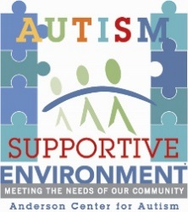
Why is it important to understand ASD?
Remember, 1 in 59 children in the U.S. are diagnosed with ASD. Those individuals could be:
Your family
Your friends
Co-workers
Neighbors
Patrons
Employees
Anderson Center Consulting can help you to support these individuals and their families by working with you to become an:
Autism Supportive Environment℠
Community Partnership Designed to:
Assist businesses in understanding and supporting individuals with ASD
Provide increased opportunities for families to enjoy and engage with local establishments
Raise Autism Awareness in the community

Slide 30
Current and Future Directions
Anderson Center Consulting is working towards expansion of Autism Supportive Programs. Areas include:
Autism Supportive Work Environments
Train and support businesses to recruit and employ individuals with ASD
Autism Supportive Learning Environments
Collaborate with public schools, colleges, tech programs to facilitate truly inclusive educational opportunities
Autism Supportive Communities
Partner with key community representatives to build networks of supportive establishments

Slide 31
To learn more about Anderson Center Consulting watch our video This video can be viewed at: https://www.youtube.com/watch?v=zh7VcLskzYg

Slide 32
Contact us for more information
Anderson Center Consulting
845-889-9616
AndersonConsulting@AndersonCares.org
Visit us on the web:
www.andersoncenterforautism.org/community-based-services

Slide 33
References and Resources
www.cdc.gov
www.autismspeaks.org
www.autism.com
www.autismsociety.org
American Psychiatric Association (1994). Diagnostic and
Statistical Manual of Mental Disorders (DSM-5) (5th ed.).
Washington, DC: Author.

